Slide 1
HYPERBOLIC WORD EMBEDDINGS
Alexandru Tifrea ,
Gary Becigneul,
Octavian-Eugen Ganea

Slide 2
ABSTRACT
- Words have varying importance and hidden connections.
- Researchers have a new method to understand words without human guidance.
- They use a special math-based way to represent words.
- This method outperforms existing techniques in various word-related tasks, including classification.

Slide 3
INTRODUCTION
1. Word embeddings are essential for natural language processing, converting words into a format suitable for deep learning models.
2. Popular models like Glove, Word2Vec, and FastText learn word vectors from raw text data based on co-occurrence statistics.
3. The proposed approach combines point embeddings and Gaussian embeddings, addressing the limitations of both.
4. It introduces a principled "is-a" score for hypernymy detection.

Slide 4
5. The new method performs well in word similarity, analogy, and hypernymy tasks continuously.
6. Hyperbolic geometry is chosen due to the concept of "average δ-(Delta)hyperbolicity."
7. Real-world graphs often exhibit hyperbolic geometry, which suits word representations due to low average δ-hyperbolicity constants.

Slide 5
Recent Approaches in Embedding Graphs and Hierarchies
- Recent methods aim to embed graphs into low-dimensional spaces to improve link prediction, using order, hyperbolic geometry, or both.
- Learning word embeddings with hierarchical info is done through supervised and unsupervised methods, which may rely on external data like WordNet.
- Some recent attempts to learn unsupervised word embeddings in hyperbolic space face issues, such as poor performance, asymmetric relation modeling, and small training datasets.
- The authors intend to address these challenges and improve hypernymy detection in unsupervised word embeddings by connecting with density-based methods.

Slide 6
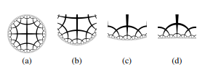
HYPERBOLIC SPACES AND THEIR CARTESIAN PRODUCT
When working with hyperbolic space, there are several mathematical models available. In this case, we have selected one particular model out of five isometric models. The chosen model is the Poincaré ball for representing Hyperbolic space, denoted as D n = {x ∈ R n|||x||2 < 1}.
In simpler terms, this represents a ball in n-dimensional space where the distance of any point inside the ball from the origin represented by (x) is less than 1.

Slide 7
HYPERBOLIC SPACES AND THEIR CARTESIAN PRODUCT
This illustrates the concept in two dimensions (n=2). the dark lines in the Poincaré ball represent geodesics, which are the shortest paths between two points in a curved space like a sphere or, in this case, a hyperbolic space.
This introduces the distance function (d_{D_n}(x, y) for measuring distances between points (x) and (y) in the Poincaré ball. The distance function in this hyperbolic space is given by the equation (cosh^{-1}), which is the inverse hyperbolic cosine function. This function calculates the distance between two points x and y in the Poincaré ball.

Slide 8
Euclidean GLoVe
GloVe (Global Vectors for Word Representation) is an unsupervised learning algorithm for obtaining vector representations for words.
Learning word representations in the Euclidean space from statistics of word co-occurrences in a text corpus,
Geometrically capture the words meaning and relations.

Slide 9
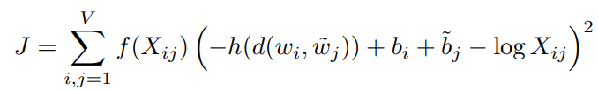
V = size of the vocabulary
f = down-weights the signal coming from frequent words
W_{i} = target word
w˜_{j} = context word
b =bais
h = function to be chosen as a hyperparameter of the model
d = can be any differentiable distance function

Slide 10
Gaussian Embeddings
Represent words in Gaussian.
Use Mean Vector (μ) and Covariance Matrix (σ)
Covariance is tells how spread specific words meaning are.
Hyperbolic Embeddings
Hyperbolic spaces better for representing words in tree like structure
Great for capturing hierarchy and relationships

Slide 11
Analogies For Hyperbolics
Finding relationships between words in a word embedding space. For example : "Paris" is related to "France" as "Tokyo" is related to "Japan"
d = c + (b - a) = b + (c - a) – a, b, c, and d are word embeddings.
Challenges with Gaussian Embeddings
Word as Gaussian distributions.
Not straightforward to perform analogy computations

Slide 12
Solution: Hyperbolic Geometry
connecting Gaussian embeddings and hyperbolic embeddings.
In hyperbolic space, "analogy parallelograms" are naturally defined, as
d1 = c ⊕ gyr[c, a](a ⊕ b) and d2 = b ⊕ gyr[b, a](a ⊕ c)
d1 and d2 differ is due to the curvature of the hyperbolic space.

Slide 13
For evaluation,
m^{t}_{d1d2} := d1 ⊕ ((−d1 ⊕ d2) ⊗ t) for t ∈ [0, 1]
if t = 1/2, this is called the gyro-midpoint and then m^{0.5}_{d1d2} = m^{0.5}_{d2d1} which is at equal hyperbolic distance from d1 as from d2.
Measure analogy relationships at different points along the path.
Continuously deforming the hyperbolic space into the Euclidean space allows to recover analogy computations as they would appear in a standard Euclidean space.

Slide 14
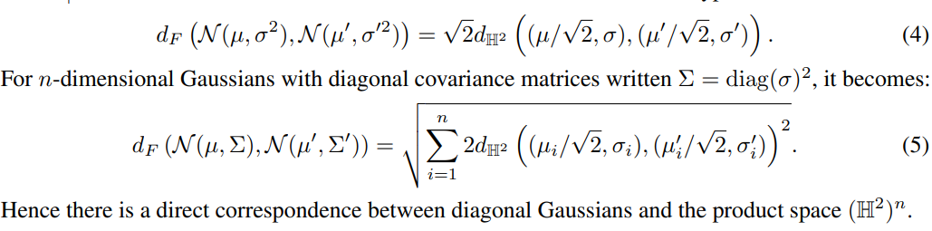
Fisher geometry
Describes Gaussian Embeddings and is hyperbolic

Slide 15
Fisher Distance and KL (Kullback-Leibler) Divergence
measuring the two probability distributions.
compare how similar or dissimilar two Gaussian distributions.
Riemannian optimization
RADAGRAD : Adjusting and fine-tuning the embeddings in hyperbolic spaces
Provides better results

Slide 16
TOWARDS A PRINCIPLED SCORE FOR ENTAILMENT/HYPERNYMY
Defining Generic and Specific Sets:
The procedure begins by defining two sets of words: G (generic) and S (specific). These sets represent word embeddings in the hyperbolic space that are believed to be generic and specific, respectively.
Isometry for Alignment:
The correct isometry (geometric transformation) is applied to the word embeddings to align them correctly for comparison. This alignment is essential to ensure that the is-a score is calculated accurately.

Slide 17
3. Translation and Rotation:
The embeddings undergo two operations:
Mobius Translation: All word embeddings are translated by a global mean, which is computed as the average of the means of the generic and specific word embeddings. This translation aligns the embeddings correctly.
Rotation: The embeddings are rotated so that a specific word is mapped to a specific point in the hyperbolic space (in this case, (0, 1)).
4. Coordinate Conversion:
The embeddings are converted from Poincaré disk coordinates to half-plane coordinates. The authors refer to this conversion as "poincare2halfplane."

Slide 18
5. Mapping to Gaussian Parameters:
The half-plane coordinates are further transformed into Gaussian parameters, specifically, mean (µ) and variance (σ). This mapping is based on specific mathematical formulas. Each coordinate in the half-plane is used to calculate the corresponding mean and variance for the Gaussian distribution.
6. Is-a Score Calculation:
The final step involves calculating the is-a score between the two sets of embeddings (generic and specific) using the Gaussian parameters. The is-a score is calculated for each coordinate and is the difference between the logarithms of the variances of the corresponding Gaussian distributions.

Slide 19
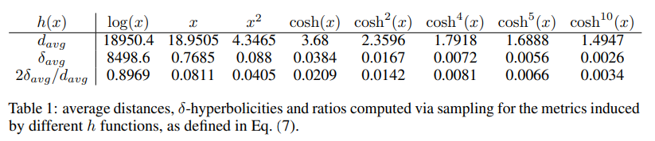
The results suggest that the discrete metric spaces obtained from their symbolic data of co-occurrences have low hyperbolicity. This implies that embedding words in hyperbolic spaces, or products of hyperbolic spaces, could be a suitable approach.

Slide 20
EMBEDDING SYMBOLIC DATA IN A CONTINUOUS SPACE WITH MATCHING HYPERBOLICITY
δ-Hyperbolicity:
This number helps us understand how much a space is like a tree. A low number means the space is tree-like, which can be good for understanding word connections.
Computing δavg:
To find this δ-hyperbolicity number for their data, we need to calculate the distances between pairs of words. But they only have information about how similar words are, not how far apart they are.

Slide 21
EXPERIMENTS: SIMILARITY, ANALOGY, ENTAILMENT
1.Dataset: Trained word embedding models on an English Wikipedia corpus with 1.4 billion tokens, filtering out words appearing less than 100 times.
2.Model Types: Used Poincare models and Euclidean GloVe models for similarity and analogy tasks.
3.Hyperbolic Models: Employed two different hyperbolic functions for Poincare models: h(x) = x^2 and h(x) = cosh^2(x).

Slide 22
4.Learning Rates: Euclidean GloVe and Poincare models with h(x) = x^2 used learning rate 0.05, while Poincare models with h(x) = cosh^2(x) used learning rate 0.01.
5.Similarity Results: Poincare models generally outperformed vanilla GloVe models in word similarity tasks.

Slide 23
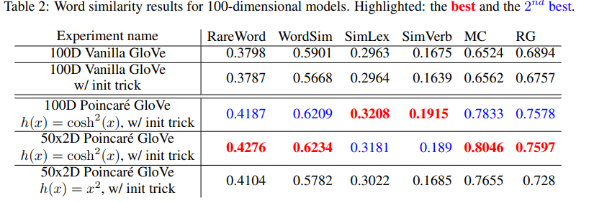

Slide 24
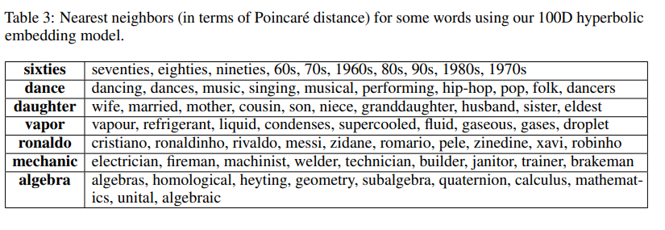

Slide 25
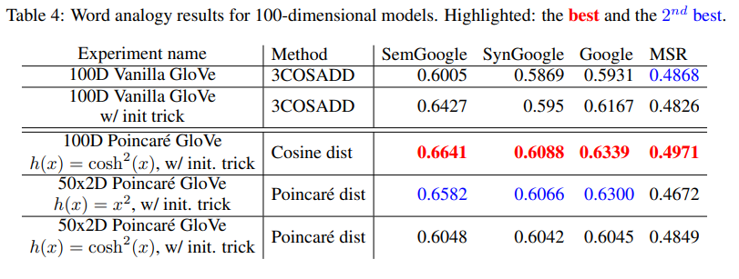

Slide 26
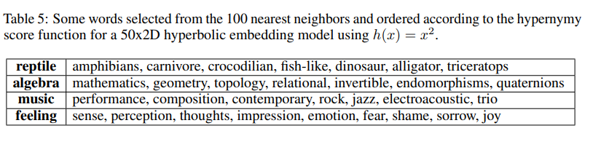

Slide 27
Hypernymy results discussion
In this section demonstrating that their hyperbolic word embeddings are capable of capturing hierarchical relationships between words effectively, even in an unsupervised setting.
This indicates that their hyperbolic embeddings capture hierarchical word relationships effectively without the need for extensive supervision.

Slide 28
CONCLUSION
The paper concludes by proposing the adaptation of GloVe for hyperbolic spaces, leveraging the connection to Gaussian distributions.
It justifies the choice of hyperbolic spaces, and presenting a groundbreaking achievement the first model that excels in word similarity, analogy, and hypernymy detection simultaneously.

Slide 29

THANK YOU
Scan For More Information :

